Slide 1


Simple animation, User Input
Speaker:
Andrii Rudyk

Slide 2

Animations Overview
Animations can add visual cues that notify users about what's going on in your app. They are especially useful when the UI changes state, such as when new content loads or new actions become available. Animations also add a polished look to your app, which gives it a higher quality look and feel.

Slide 3
Animation Types
Animate bitmaps - animate a bitmap graphic such as an icon or illustration
Animate UI visibility and motion - When you need to change the visibility or position of views in your layout, you should include subtle animations to help the user understand how the UI is changing
Physics-based motion - whenever possible, your animations should apply real-world physics so they are natural-looking
Animate layout changes - when you swap the layout within the current activity or fragment
Animate between activities - this is based on the same transition framework described above to animate layout changes, but it allows you to create animations between layouts in separate activities.

Slide 4
MotionLayout
MotionLayout is a new class available in the ConstraintLayout 2.0 library to help Android developers manage motion and widget animation in their application.
MotionLayout was created to bridge the gap between layout transitions and complex motion handling. You can think of it in terms of capabilities as a mix between the property animation framework, TransitionManager, and CoordinatorLayout.

Slide 5
Limitations
MotionLayout will only provide its capabilities for its direct children — contrary to TransitionManager, which can work with nested layout hierarchies as well as Activity transitions.
The scenarios we envision for MotionLayout are when you need to move, resize or animate the actual UI elements — buttons, title bar, etc. — elements that the user needs to interact with.

Slide 6
Adding MotionLayout
dependencies {
implementation 'androidx.constraintlayout:constraintlayout:2.0.0-beta1'
}

Slide 7
Using MotionLayout
MotionLayout is a subclass of ConstraintLayout — as such, you can treat it like a normal layout. To transform an existing ConstraintLayout into a MotionLayout is as easy as replacing the class name from:
<android.support.constraint.ConstraintLayout .../>
to MotionLayout:
<android.support.constraint.motion.MotionLayout .../>

Slide 8
ConstraintSets
The general idea with ConstraintSet is that they encapsulate all the positioning rules for your layout; and as you can use multiple ConstraintSet, you can then decide which set of rules to apply to your layout, on the fly, without having to recreate your views — only their position/dimensions will change.
Notes:
https://medium.com/google-developers/introduction-to-motionlayout-part-ii-a31acc084f59

Slide 9
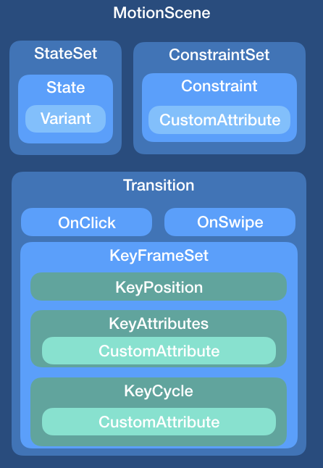
MotionScene
A MotionScene file can contain all that is needed for specifying the animation:
the ConstraintSets used
the transition between those ConstraintSets
keyframes, touch handling, etc.

Slide 10
Create ConstraintSets
With ConstraintLayout, you would create two ConstraintSets — one for the first position (with the widget on the left of the screen), and a second one for the second position (with the widget on the right of the screen).
<android.support.constraint.ConstraintLayout
xmlns:android="http://schemas.android.com/apk/res/android"
xmlns:app="http://schemas.android.com/apk/res-auto"
android:layout_width="match_parent"
android:layout_height="match_parent">
<View
android:id="@+id/button"
android:background="@color/colorAccent"
android:layout_width="64dp"
android:layout_height="64dp"
android:layout_marginLeft="8dp"
android:text="Button"
app:layout_constraintBottom_toBottomOf="parent"
app:layout_constraintStart_toStartOf="parent"
app:layout_constraintTop_toTopOf="parent" />
</android.support.constraint.ConstraintLayout>
<android.support.constraint.ConstraintLayout
xmlns:android="http://schemas.android.com/apk/res/android"
xmlns:app="http://schemas.android.com/apk/res-auto"
android:layout_width="match_parent"
android:layout_height="match_parent">
<View
android:id="@+id/button"
android:background="@color/colorAccent"
android:layout_width="64dp"
android:layout_height="64dp"
android:layout_marginRight="8dp"
android:text="Button"
app:layout_constraintBottom_toBottomOf="parent"
app:layout_constraintEnd_toEndOf="parent"
app:layout_constraintTop_toTopOf="parent" />
</android.support.constraint.ConstraintLayout>

Slide 11
Create MotionLayout, MotionScene
<android.support.constraint.motion.MotionLayout
xmlns:android="http://schemas.android.com/apk/res/android"
xmlns:app="http://schemas.android.com/apk/res-auto"
xmlns:tools="http://schemas.android.com/tools"
android:id="@+id/motionLayout"
android:layout_width="match_parent"
android:layout_height="match_parent"
app:layoutDescription="@xml/scene_01"
tools:showPaths="true">
<View
android:id="@+id/button"
android:layout_width="64dp"
android:layout_height="64dp"
android:background="@color/colorAccent"
android:text="Button" />
</android.support.constraint.motion.MotionLayout>
<MotionScene xmlns:motion="http://schemas.android.com/apk/res-auto">
<Transition
motion:constraintSetStart="@layout/motion_start"
motion:constraintSetEnd="@layout/motion_end"
motion:duration="1000">
<OnSwipe
motion:touchAnchorId="@+id/button"
motion:touchAnchorSide="right"
motion:dragDirection="dragRight" />
</Transition>
</MotionScene>

Slide 12
Create ConstraintSet
One important thing to keep in mind is how ConstraintSet works — they will replace all existing constraints of the affected widgets.
You thus need to have each Constraint element contain all the constraints you want to apply to the widget.
<ConstraintSet android:id="@+id/start">
<Constraint
android:id="@+id/button"
android:layout_width="64dp"
android:layout_height="64dp"
android:layout_marginStart="8dp"
motion:layout_constraintBottom_toBottomOf="parent"
motion:layout_constraintStart_toStartOf="parent"
motion:layout_constraintTop_toTopOf="parent" />
</ConstraintSet>
<ConstraintSet android:id="@+id/end">
<Constraint
android:id="@+id/button"
android:layout_width="64dp"
android:layout_height="64dp"
android:layout_marginEnd="8dp"
motion:layout_constraintBottom_toBottomOf="parent"
motion:layout_constraintEnd_toEndOf="parent"
motion:layout_constraintTop_toTopOf="parent" />
</ConstraintSet>
Notes:
The MotionScene is where things differ; the Transition definition is the same, but we put the definition of the start and end ConstraintSets directly in the file. The main difference from a normal layout file is that we do not specify the type of widgets used here — instead we put the constraints as attribute of a Constraint element.

Slide 13
Custom attribute
Within a Constraint, you can use the CustomAttribute element to specify a transition for attributes that aren't simply related to position or View attributes.
<ConstraintSet android:id="@+id/start">
<Constraint
android:id="@+id/button"
...
motion:layout_constraintTop_toTopOf="parent" >
<CustomAttribute
motion:attributeName="backgroundColor"
motion:customColorValue="#D81B60" />
</Constraint>
</ConstraintSet>
<ConstraintSet android:id="@+id/end">
<Constraint
android:id="@+id/button"
...
motion:layout_constraintTop_toTopOf="parent" >
<CustomAttribute
motion:attributeName="backgroundColor"
motion:customColorValue="#9999FF" />
</Constraint>
</ConstraintSet>

Slide 14

Thank you!

